Slide 1
Sprint 3 MVP
Q U E S T
A journey into the unknown, the choice is up to you
By Team CodeSaurus

Slide 2
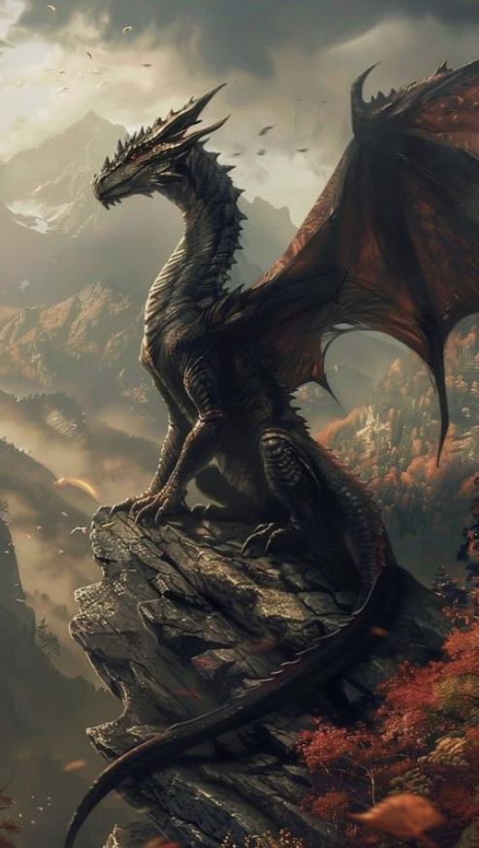
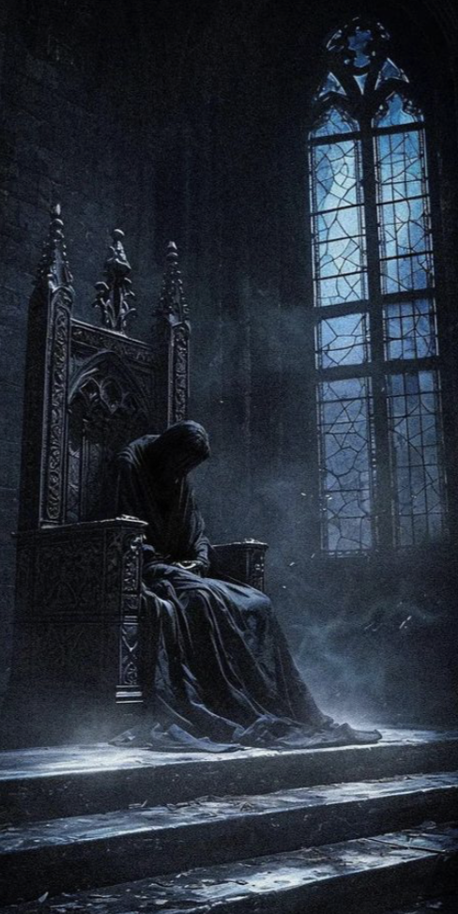



Encounter
the Lords
of Evil
Roll the dice,
Follow the story,
See where your choices lead you.
Or
delve
into a
magical
world
Or wander deep into the Dark Forest
Explore the world of Dragons

Slide 3
Agenda
Team Member Roles | Improvements | Responsibilities
Problem Statement | Project Description | Team Working Agreement
User Personas | MVP | Project Design
Technologies | Algorithms | Diagrams
Sprint 1 Recap
Product Backlog
Sprint 2 Recap
User Stories
Test Cases
Stories Completed/Not Completed
Stories Not Completed
9. Metrics
Team Velocity
Committed/Completed Ratio
10. Sprint 3
11. Retrospective
12. Project Demo

Slide 4
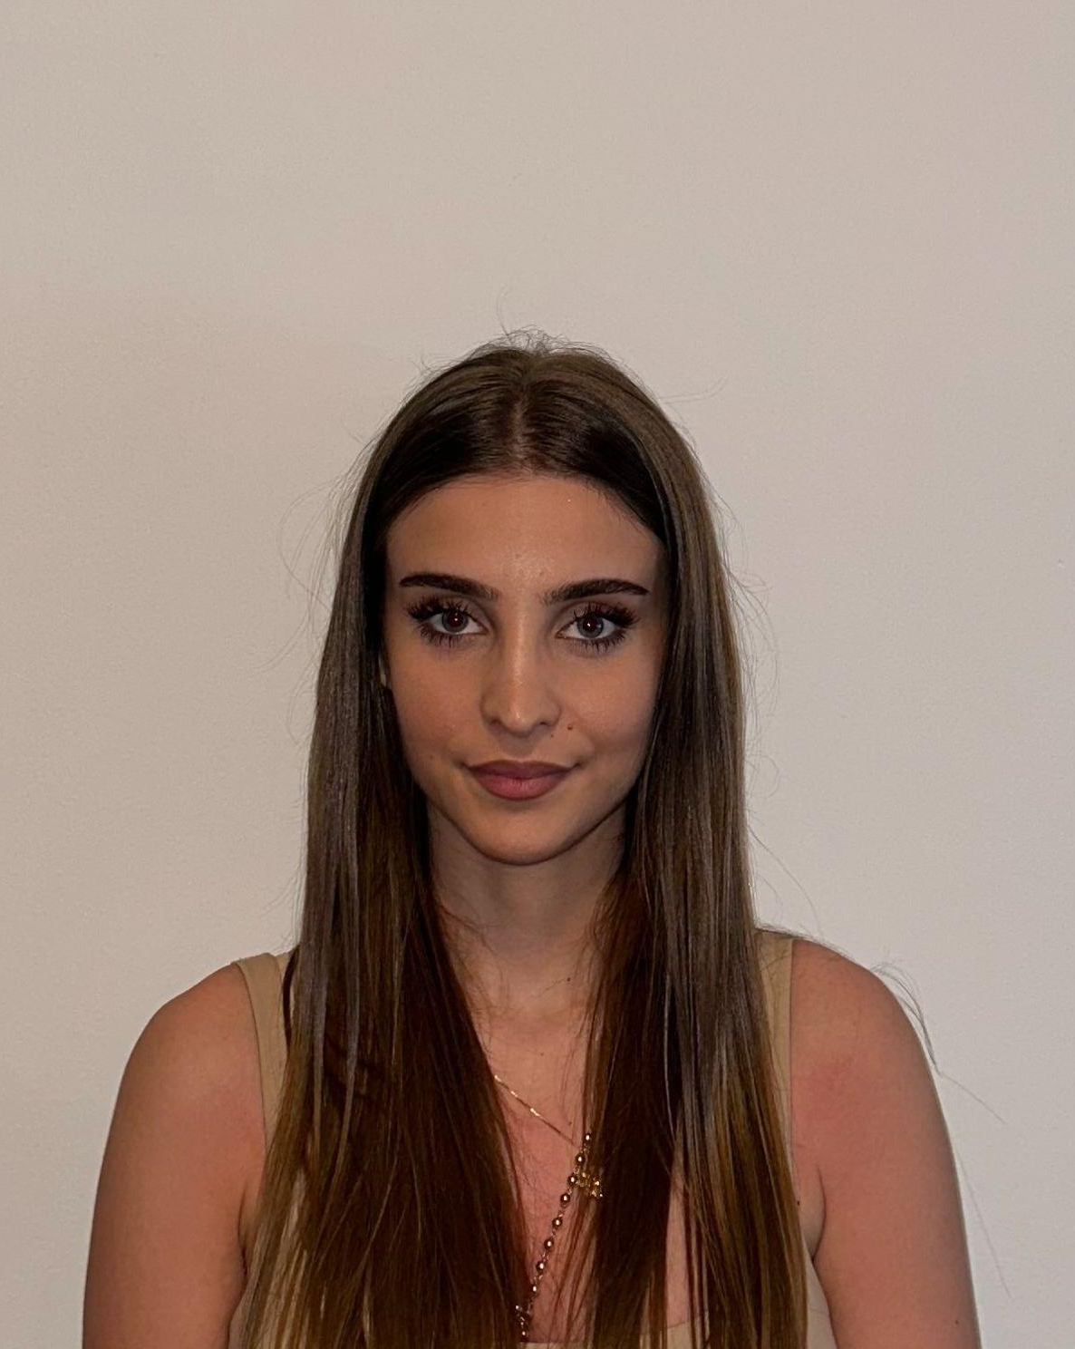

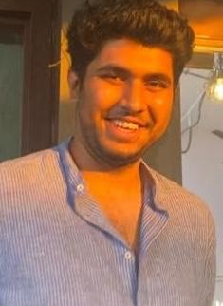

Getting to know the Team…
Ajla Hate
Clive Lewis
Dhruv Joshi
Mrunmai Nagtode
Backend Developer
Developer / Tester
Scrum Master / Developer
Developer / Tester

Slide 5



Getting to know the Team…
Dylan Pereira
Farham Khademi
Sharon Dsouza
Full Stack Developer
Team Lead / Developer
Full Stack Developer

Slide 6

Improvements
No feedback
Notes:
- remove introduction improvement point
- keep only improvement points that you learn in this class (Agile related things)
- project description: "unlike competitors our". we have it but need it earlier
- tech stack: separate slides. maybe?
- agenda numbers are wrong
- schedule is good
- crop the sequence diagrams into events and name them
- forgot comma for us_10 "as a user, "
- feature column is not needed
- use last sprint as reference
- user stories need to be same writing style
- use modified fib numbers
- cap the story points and then break it into smaller (ours
- need user role (player)
- add an admin role
- dont need backlog overview (dont need sprints in there) can leave it but not required
- US_19 has same acceptance criteria
- add title to excel screenshots
- testcase: liked that we have passed and fail, who did, when executed
- actual result for test case needed
- another column for test cases: user story ref
- relative sizing something for sprint 1 backlog (I hope you got it Farham because I zoned out)
- subtask dont have points
- Velocity have to be corrected based on big
- Ratio isn't given
- Burndown chart: should start from the gray line
- only user stories carry over not the task (sprint 1 backlog)
- in ppt, run them through timeline of events in burndown chart
- take out sprint review for sprint 0 (keyword thing)
- prototype link good
- prototype needs to be something that works (simple is fine)
- not everyone participated - retrospective
- not everyone participated - sprint planning
- not everyone participated - presentation
- need introductions
- demo link on the wiki: video is fine (timestamp youtube video)
- deliverable to sprint (keyword change)
- look at team 2 tech presentation
- show some code in the demo
- dot voting (3-5 votes, can put all in one ticket or spread,

Slide 7
What problem are we solving?
Limited flexibility in RPGs (Role Playing Games)
Lack of imagination/creative inspiration
Realization of a story that lives in your mind
Effective way to work through creative blocks
Quest tackles these challenges using an an AI-driven narrator

Slide 8


Our Solution Existing Solutions
Unlimited Choices
Dynamic Story Generation
Context Awareness
Enhanced Immersion
Multiplayer
Accessibility Features

Slide 9
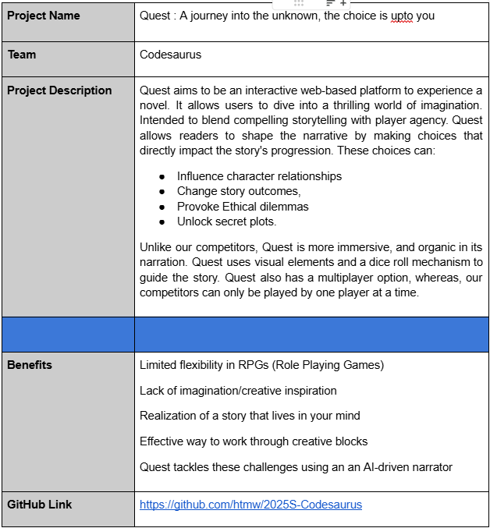
Project Description : Quest GitHub
What is Quest?
Quest aims to be an interactive web-based platform to experience a novel
Allows users to dive into a thrilling world of imagination
Intended to blend compelling storytelling with player agency
Allows readers to shape the narrative by making choices that directly impact the story's progression
These choices can:
Influence character relationships
Change story outcomes
Provoke ethical dilemmas
Unlock secret plots

Slide 10
Team Working Agreement
Meeting Schedule and Pattern:
Meetings will be scheduled twice a week (thrice in event of a recording to be produced) i.e. Sunday and Tuesday.
Time of the meetings to be decided based on an availability.
Meeting will have a fixed Agenda document to help team members prepare for the meeting items to be discussed.
Team members are encouraged to proactively schedule meetings to work and collaborate on their assigned work if required.
Sprint Plan will be devised in the first team meeting scheduled after a Sprint has been completed.
Last meeting of the sprint will be for retrospective.
Absence from a meeting must be informed in advance. The team member is expected to read the meeting summary posted in the channel, in order to work on assigned task.
Every team member is expected to actively participate in contributing each team meeting in their capacity.
Communication Expectations
Communication/Collaboration Channels: Slack, Zoom Meetings, Emails, GitHub, Google Workspace.
All opinions and recommendations should be respected and taken into consideration during the decision making process.
In the event where a team member may want to divert away from a planned activity due to any reason, the team should be informed with a short description of the change on the communication channel.
In the event of an opinion based conflict both parties may list the respective research and solutions with regards to their respective opinions and the team may vote on majority to select the respective idea.
Each member is expected to voice their concerns with regards to any decision/change being made during the discussion process.
Each team members should update everyone on the communication channel when they push their code on Github to alert everyone and avoid merge conflicts as much as possible.
Any changes to the master branch must be informed to the team.

Slide 11
Team Working Agreement
Team Dynamics And Principles:
Every team member should be treated with kindness, respect and patience even when it feels impossible.
Every team member clearly understands their responsibilities and tasks..
Workload will be distributed as evenly as possible. Single tasks with heavy workload may be broken down into smaller smaller manageable tasks.
Every task should have a deadline and a review on completion.
Every team member is encouraged to try and resolve blockers encountered and document their list of tried solutions before approaching the team.
Jira trackers should be updated regularly.
Work done should be linked to Jira tracker either in the form of a github commit id whenever possible.
Work should be updated/shared through GitHub.
Checklist for marking a Task as Completed:
Code should run without any form of syntactical or runtime errors.
Code should meet all acceptance criteria.
Work should be reviewed and tested by the assigned team member.
Code should be pushed to respective branch and appropriate pull request should be raised for review.
All relevant documentation should be tagged/updated alongside.
Work should be reviewed by multiple team members before Production is updated.

Slide 12

The Reader Persona
Name: Betty Thompson
Age: 41
Gender: Female
Occupation: Data Analyst
Betty is a mom, who enjoys reading romance novels in her free time. She often
finds herself wondering what it would feel like to be in one, living the story. She is part of a book
club where she and her friends analyze plots, characters, and alternate possibilities in stories.
Challenges:
- Finds most romance novels predictable, with similar plot structures and outcomes.
- Gets frustrated when the characters from the book make the same obvious decisions over and over.
- When discussing alternate “what-if” scenarios with her book club, it often leads to unresolved debates.
Goals:
- She enjoys the books but wants a way to interact with the story, without coming up with it from scratch.
- Wants to explore the ways in which a story can unfold if different choices were made even when plots remain the same.
- Seeks a fun way to test out all the theories in a way that can be shared with her book club friends.

Slide 13

The Novelist Persona
Name: John Olwen
Age: 36
Gender: Male
Occupation: Novel Writer
He is an old school writer who prefers a typewriter to a computer. John navigates the city using
public transport, always looking to be inspired by people and his surroundings. Like any writer,
John also struggles with creative aspects of his profession.
Challenges:
- He struggles with creative blocks while panning out one/more characters and their influence on the storyline.
- Struggles to discuss ideas with friends and colleagues due to worries about revealing too much, finds online resources overwhelming.
- Finds it hard to completely immerse himself into characters without letting his biases get in the way.
Goals:
- Seeks a discreet, interactive way to refine and navigate his story.
- Wants a way to explore characters with complex moralities without any personal bias or external judgement.
- Would consider using an online platform that has instructions and tutorials which are easy to follow and can guide him when he’s creatively stuck.

Slide 14

The Gamer Persona
Name: Jason Bourne
Age: 28
Gender: Male
Occupation: Associate Lawyer
He is a busy working professional, who looks forward to weekly game nights with his group
of friends. Enjoys online multiplayer games that are engaging, interactive and low effort.
Challenges:
- Struggles with finding new games that are different, can be played more than once/twice
before becoming boring and predictable.
- Finds it hard to schedule a day that works for everyone in the group for game night.
- When playing games that require storytelling and defining player roles, he and his group struggle to come up with something creative, especially after a long and busy work week.
Goals:
- Looking for a game that can be replayed fresh without getting predictable, can be one or multiplayer.
- Seeks a way to start game night without spending too much time in picking a game and setups.
- Wants to play in a dynamic environment that can easily adapt and improvise to player moves when the narrative gets overwhelming, with minimal effort required from players.

Slide 15







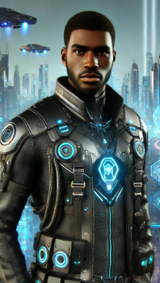
MVP
An AI-driven interactive novel with visual elements.
Dynamic Narratives - Users can shape the story.
Choice System - Type actions to interact with context.
Visual Elements - Enemy and NPC Portraits
Simple UI - Accessible to everyone
Notes:
NPC- nonplayer character

Slide 16












Technologies
Front - End
Back - End
Databases
Tools

Slide 17
Frontend
JavaScript is universally supported, making it ideal for building cross-browser web applications.
React component-based structure promotes code reuse and clean UI architecture.
Virtual DOM in React ensures fast rendering and improved performance.
Large community and ecosystem enable rapid development with abundant resources and libraries.

Slide 18
Backend
Node.js offers non-blocking I/O, making it ideal for handling real-time, high-concurrency workloads.
Express.js provides a lightweight, flexible framework for building scalable APIs quickly.
Seamless integration with OpenAI APIs enables powerful AI-driven features with minimal overhead.
JavaScript across frontend and backend simplifies development and improves team productivity.

Slide 19
Database
MongoDB’s flexible document model allows rapid development and easy handling of dynamic data.
JSON-like structure aligns naturally with JavaScript/Node.js, simplifying data handling.
Scales horizontally with ease, making it suitable for growing, high-traffic applications.
Rich querying and indexing features support powerful, efficient data operations.

Slide 20
Tools
Visual Studio Code offers a fast, extensible, and developer-friendly IDE with powerful debugging and Git integration.
GitHub ensures seamless version control and collaboration through pull requests, code reviews, and CI/CD support.
Jira enables efficient project management with clear tracking of tasks, sprints, and team progress.
Together, these tools streamline the development workflow, from coding to deployment and issue tracking.

Slide 21
Components
Player status manager: Keep track of player progress
Game status manager: Maintains game context data and behavior
AI LLM model manager: Generates dynamic narrative and dialogue
Prompt generator: Create efficient prompts with most relevant amount of metadata

Slide 22
Project Schedule
Feb 12
March 12
April 9
April 30
Sprint 0
Sprint 1
Sprint 2
Sprint 3
Problem Statement, Description
Tech stack
MVP
Team Agreement
Project Schedule
Set up tools for tasks
Sprint Presentation Recordings
Sprint Retrospective Recordings
User Stories, Acceptance Criteria
Establish the base components
OpenAI API integration
Theme Selection Feature
Preset Story Feature
Character Descriptions
Story Transcripts Feature
Narrator - User interaction
Enhance context retention
Character Creation
NPC Creations
Introduce NPC in stories
NPC and player Interactions
Dice Roll Decision Feature
End Game Implementation
Technical Paper
Culminate all work into the app
Integration
Finalize and update tech paper
Add functionalities like text-to-speech and voice-to-text.
We’ve established a semi-weekly cadence to review progress and plan next steps (unless otherwise required).

Slide 23
Diagrams

Slide 24
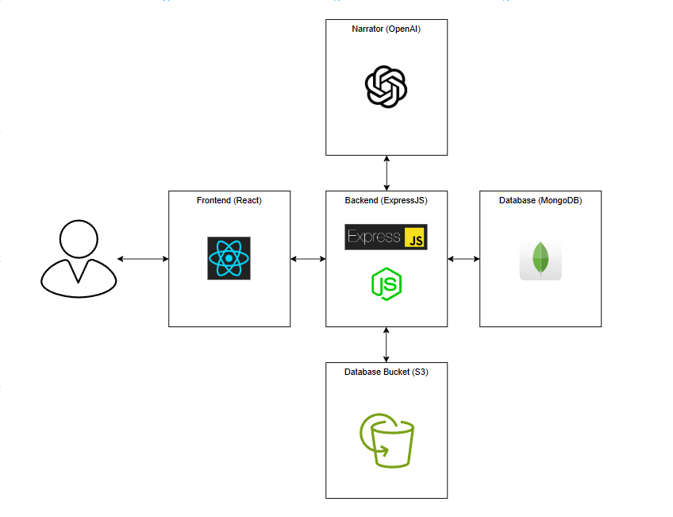
Architecture Diagram

Slide 25
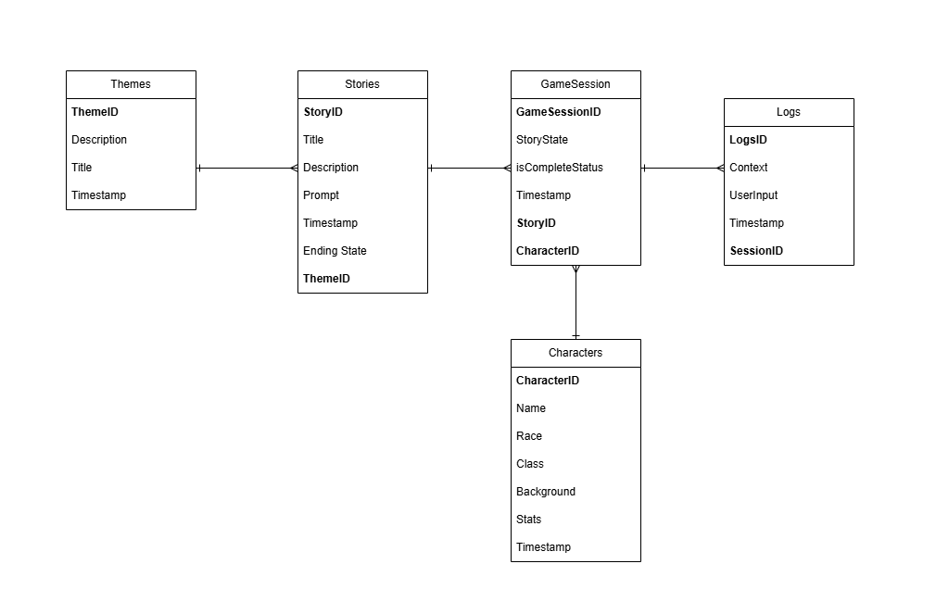
ER - Diagram

Slide 26
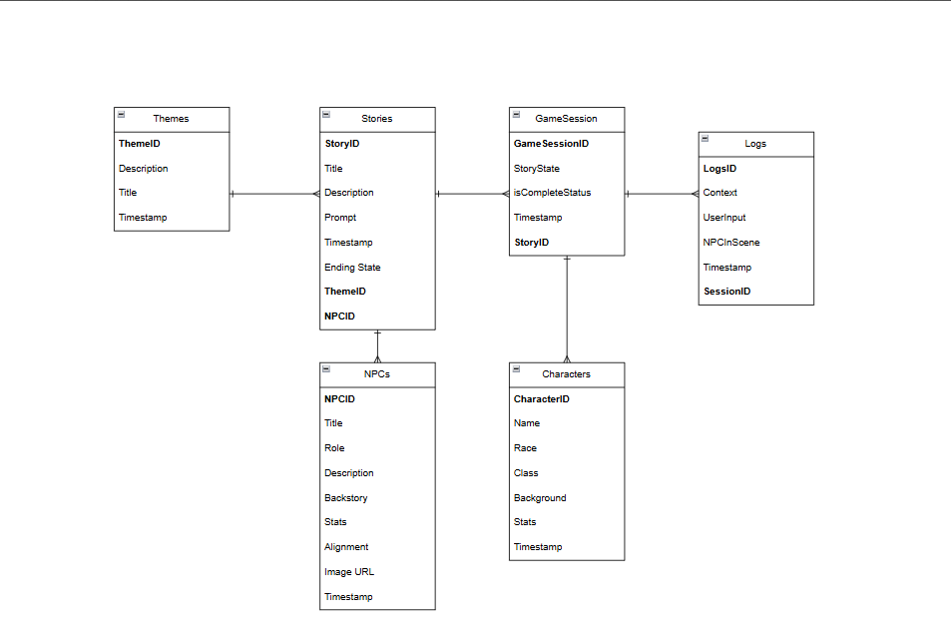
ER - Diagram

Slide 27
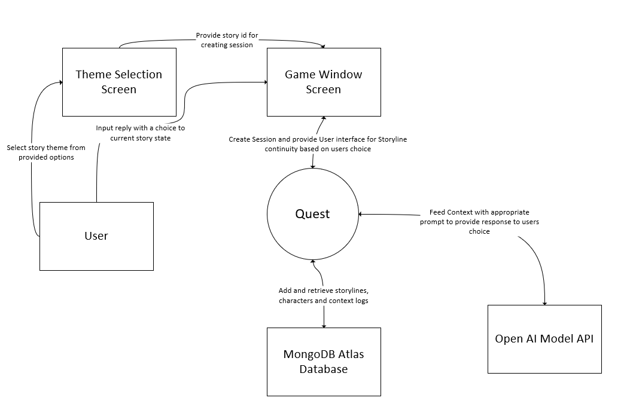
Context Diagram

Slide 28
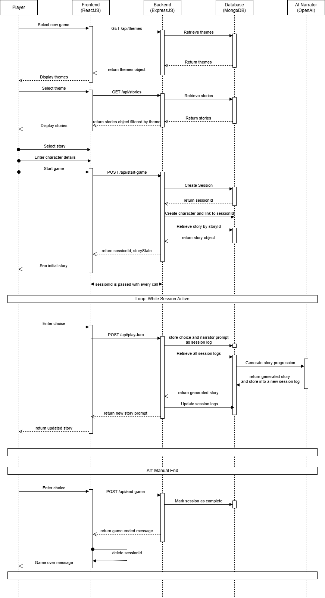
Sequence Diagram

Slide 29
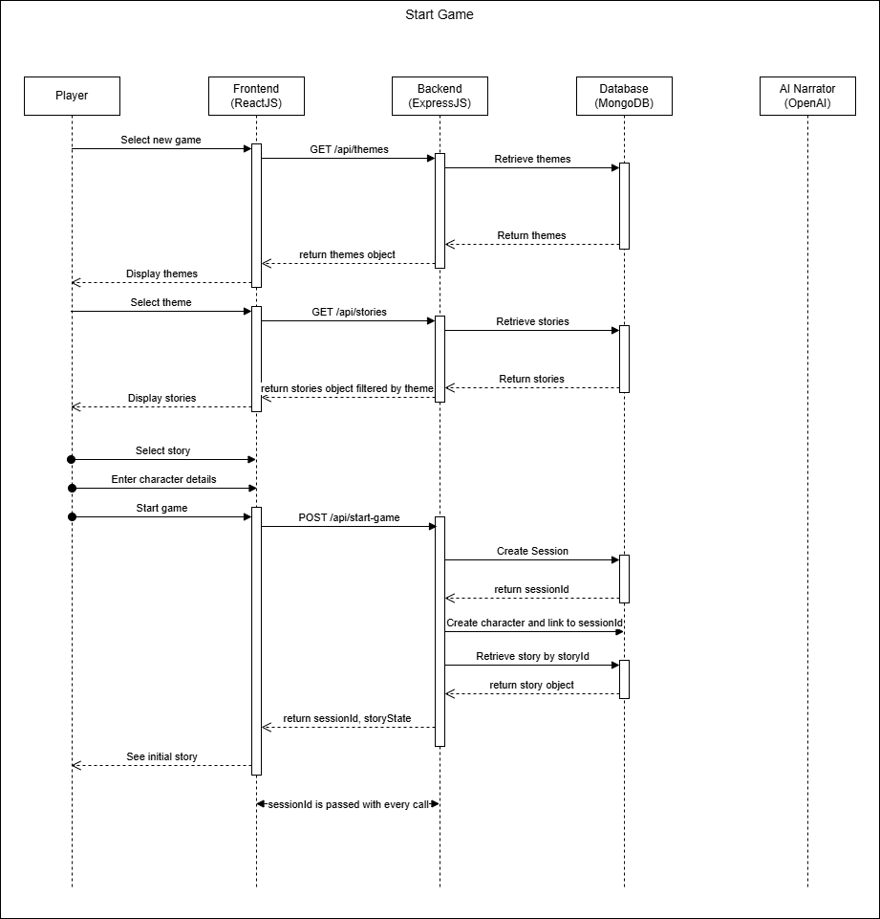
Sequence Diagram
Start Game

Slide 30
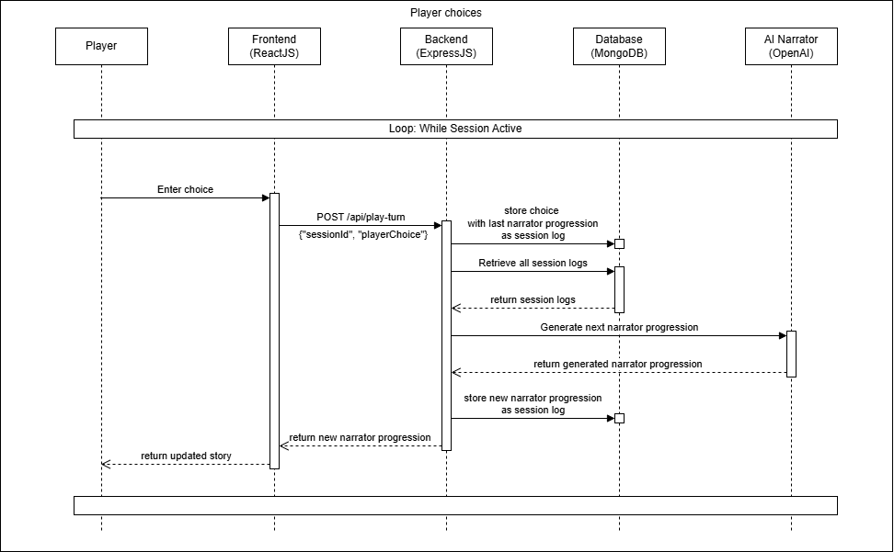
Sequence Diagram
Player Choices

Slide 31
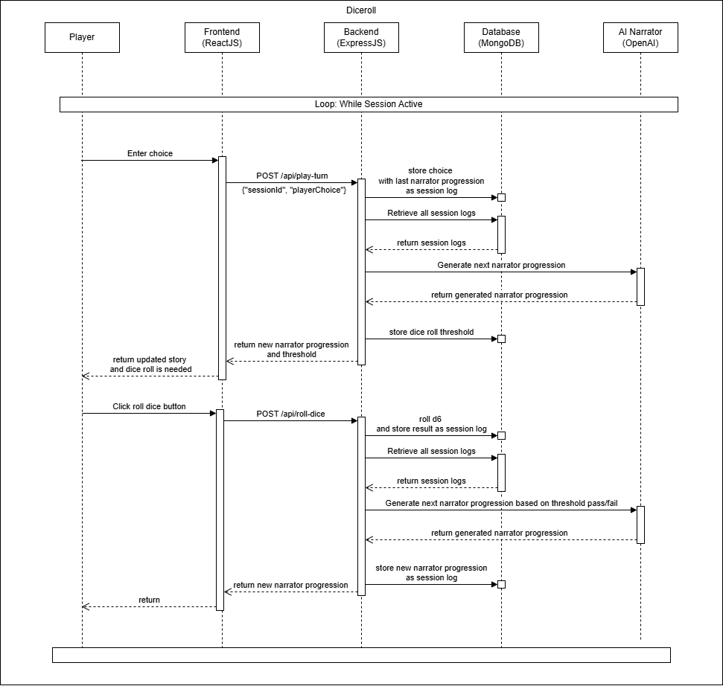
Sequence Diagram
Player Choices with Dice Roll

Slide 32
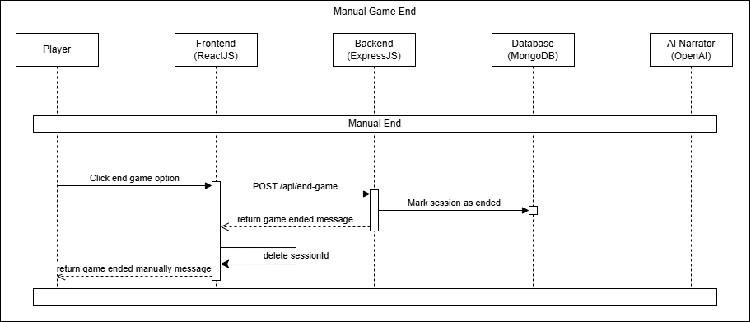
Sequence Diagram
Manual Game End

Slide 33
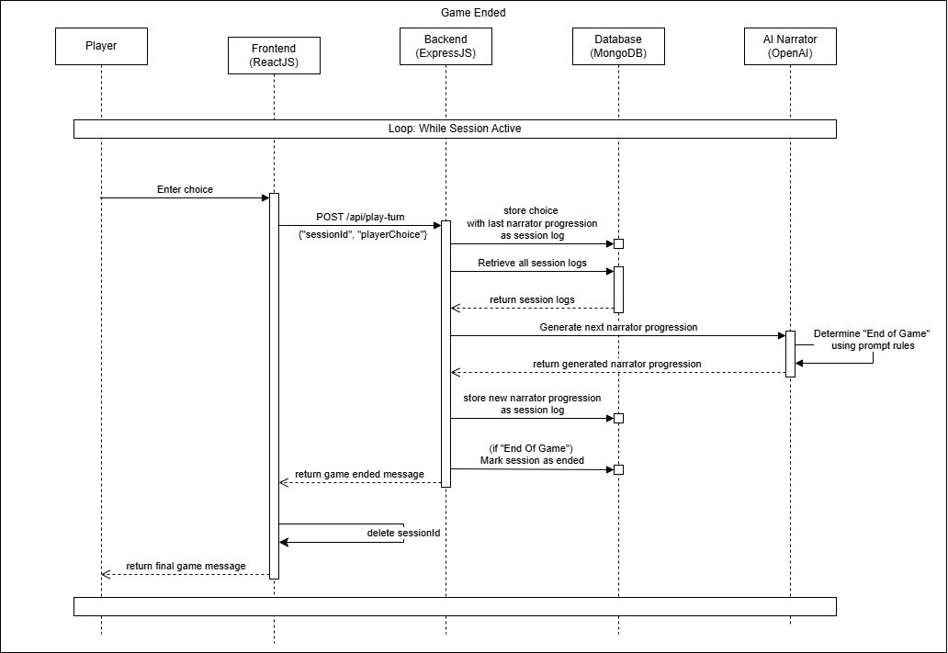
Sequence Diagram
Game End

Slide 36
SPRINT 1 Recap

Slide 37
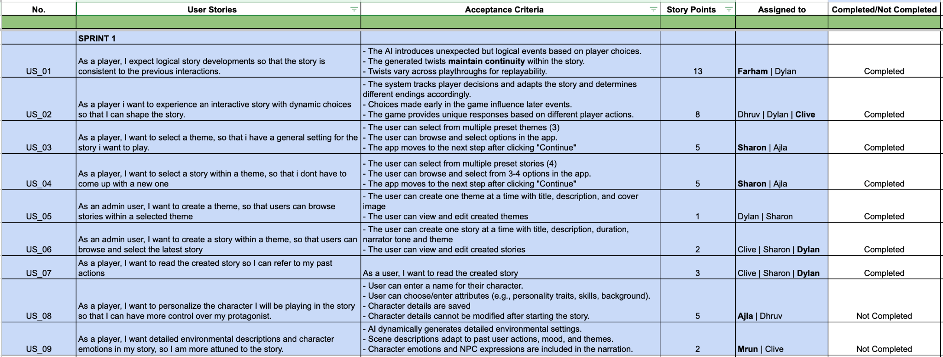
User Stories

Slide 38
Test Cases
No | User Story | Total Test Cases | Tests Passed | Tests Failed
US_01 | As a player, I expect logical story developments so that the story is consistent to the previous interactions. | 3 | 3 | 0
US_02 | As a player i want to experience an interactive story with dynamic choices so that I can shape the story. | 3 | 3 | 0
US_03 | As a player, I want to select a theme, so that i have a general setting for the story i want to play. | 3 | 3 | 0
US_04 | As a player, I want to select a story within a theme, so that i don't have to come up with a new one | 3 | 3 | 0
US_05 | As an admin user, I want to create a theme, so that users can browse stories within a selected theme | 2 | 2 | 0
US_06 | As an admin user, I want to create a story within a theme, so that users can browse and select the latest story | 2 | 2 | 0
US_07 | As a player, I want to read the created story so I can refer to my past actions | 5 | 4 | 1

Slide 39
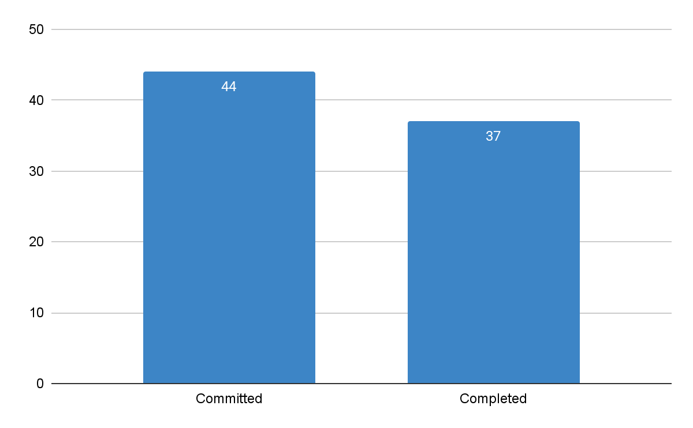
Sprint 1 Team Metrics
Team Velocity
Committed/Completed Ratio
= 84 %
Total estimated points | 44
Total points delivered | 37
Total points carried over | 7
Team Velocity | 37

Slide 40
SPRINT 2 Recap

Slide 41
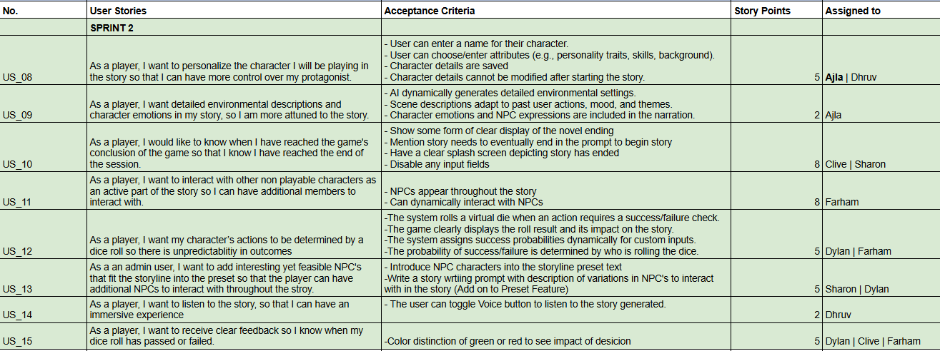
User Stories

Slide 42
Test Cases
No | User Story | Total Test Cases | Tests Passed | Tests Failed
US_08 | As a player, I want to personalize the character I will be playing in the story so that I can have more control over my protagonist. | 4 | 4 | 0
US_09 | As a player, I want detailed environmental descriptions and character emotions in my story, so I am more attuned to the story. | 2 | 2 | 0
US_10 | As a player, I would like to know when I have reached the game's conclusion of the game so that I know I have reached the end of the session. | 3 | 2 | 1
US_11 | As a player, I want to interact with other non playable characters as an active part of the story so I can have additional members to interact with. | 2 | 2 | 0
US_12 | As a player, I want my character’s actions to be determined by a dice roll so there is unpredictability in outcomes | 5 | 5 | 0
US_13 | As a an admin user, I want to add interesting yet feasible NPCs that fit the storyline into the preset so that the player can have additional NPCs to interact with throughout the story. | 2 | 2 | 0
US_14 | As a player, I want to listen to the story, so that I can have an immersive experience | 3 | 0 | 3
US_15 | As a player, I want to receive clear feedback so I know when my dice roll has passed or failed. | 4 | 4 | 0

Slide 43
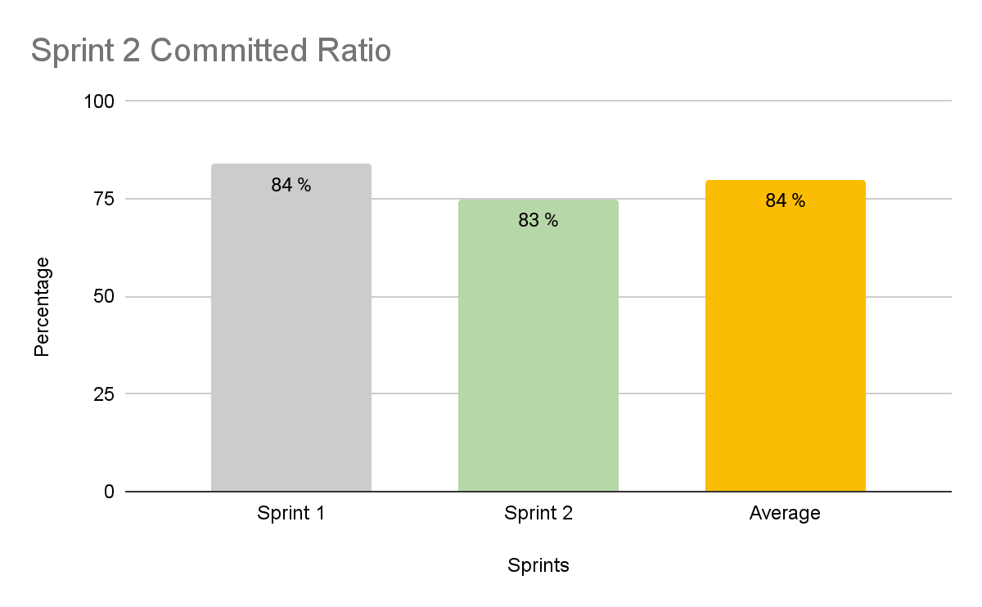
Sprint 1 Team Metrics
Committed Story points for Sprint 2: 40
Completed Story points: 30
Committed/Completed Ratio: 83%

Slide 44
Product Backlog

Slide 45
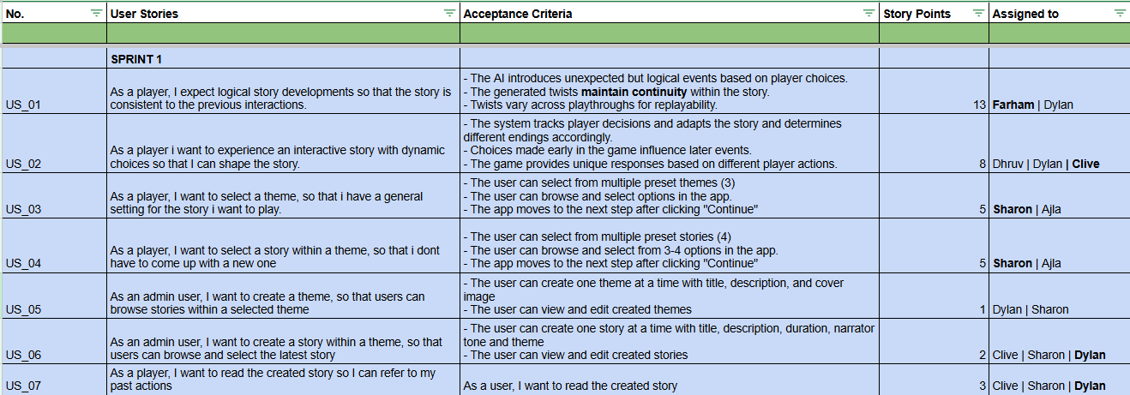

Slide 47
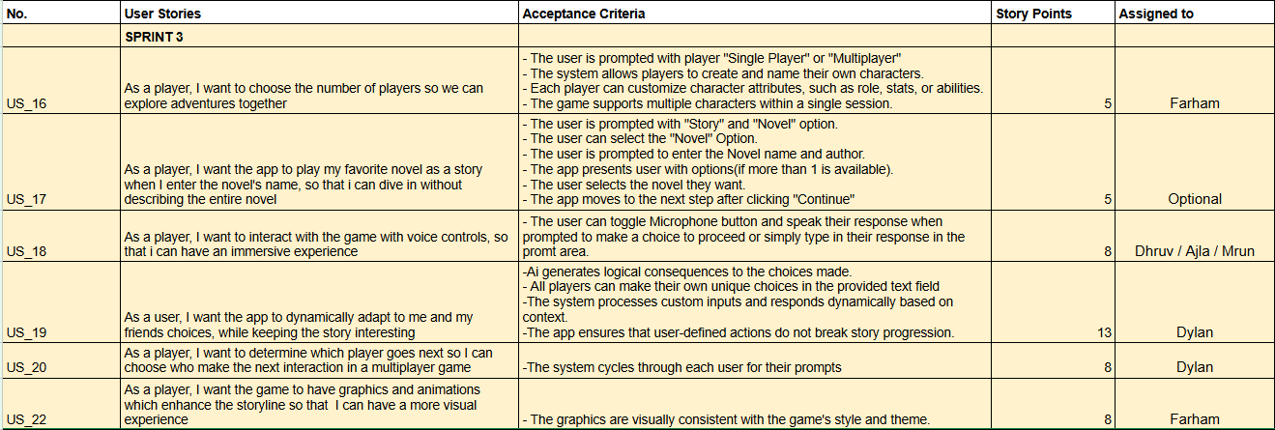

Slide 48
SPRINT 3
Notes:
Add two burntown chart sprint 1 + 2 With user stories

Slide 49
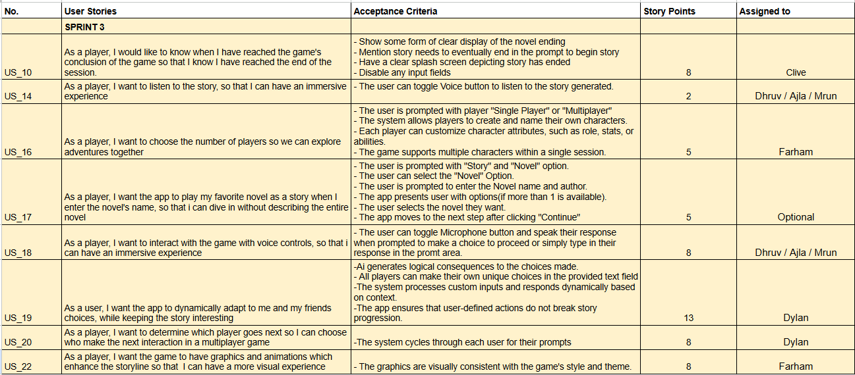
Sprint 3 Backlog

Slide 50
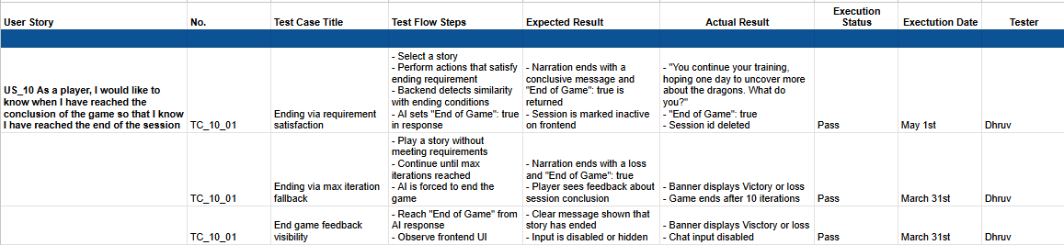
Sprint 3 Backlog: Test Cases
US_10 As a player, I would like to know when I have reached the conclusion of the game so that I know I have reached the end of the session

Slide 51
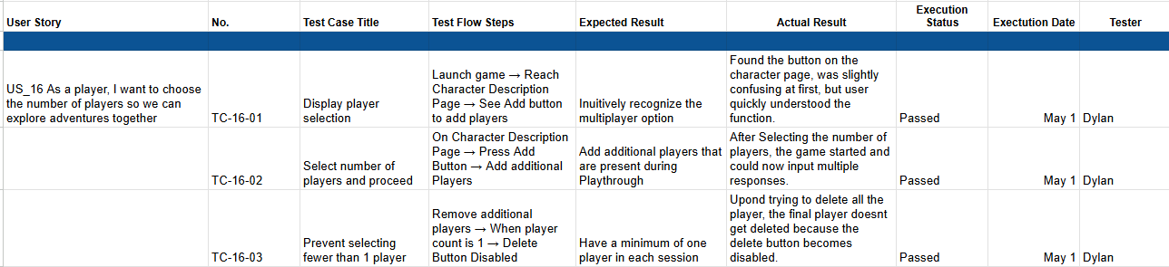
Sprint 3 Backlog: Test Cases
US_16 As a player, I want to choose the number of players so we can explore adventures together

Slide 52
Sprint 3 Backlog: Test Cases
US_18 As a player, I want to interact with the game with voice controls, so that i can have an immersive experience

Slide 53
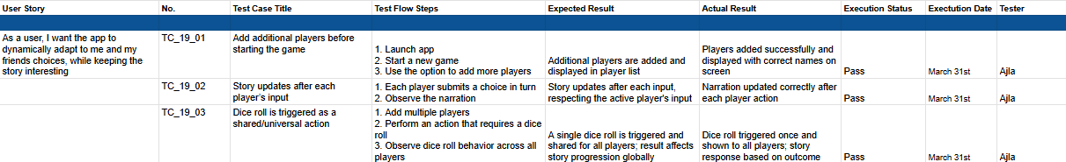
Sprint 3 Backlog: Test Cases
US_19 As a user, I want the app to dynamically adapt to me and my friends' choices, while keeping the story interesting

Slide 54
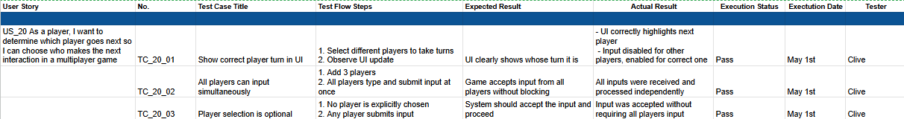
Sprint 3 Backlog: Test Cases
US_20 As a player, I want to determine which player goes next so I can choose who makes the next interaction in a multiplayer game

Slide 55
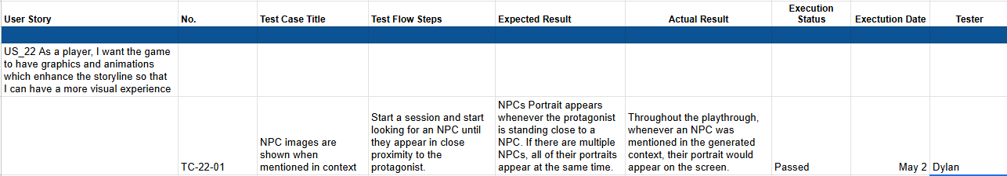
Sprint 3 Backlog: Test Cases
US_22 As a player, I want the game to have graphics and animations which enhance the storyline so that I can have a more visual experience

Slide 56
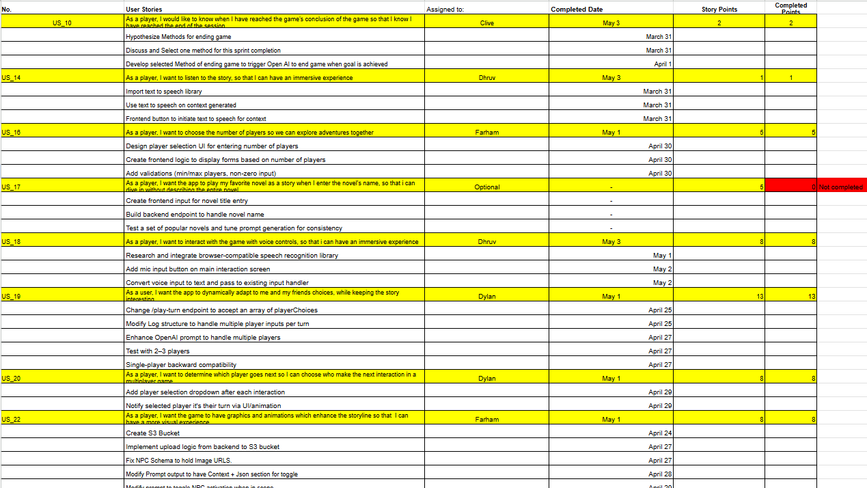
Sprint 3 Stories Completed

Slide 57
Sprint 3 Stories Completed

Slide 58
Metrics: Sprint 2
Story ID | Story Description | Story Points Estimated | Completed/Not Completed
US_10 | As a player, I would like to know when I have reached the game's conclusion of the game so that I know I have reached the end of the session. | 2 | Completed
US_14 | As a player, I want to listen to the story, so that I can have an immersive experience | 1 | Completed
US_16 | As a player, I want to choose the number of players so we can explore adventures together | 5 | Completed
US_17 | As a player, I want the app to play my favorite novel as a story when I enter the novel's name, so that i can dive in without describing the entire novel | 5 | Not Completed
US_18 | As a player, I want to interact with the game with voice controls, so that i can have an immersive experience | 8 | Completed
US_19 | As a user, I want the app to dynamically adapt to me and my friends choices, while keeping the story interesting | 13 | Completed
US_20 | As a player, I want to determine which player goes next so I can choose who make the next interaction in a multiplayer game | 8 | Completed
US_22 | As a player, I want the game to have graphics and animations which enhance the storyline so that I can have a more visual experience | 8 | Completed
Notes:
We have recorded each story and plan to do the same in future sprints.

Slide 59
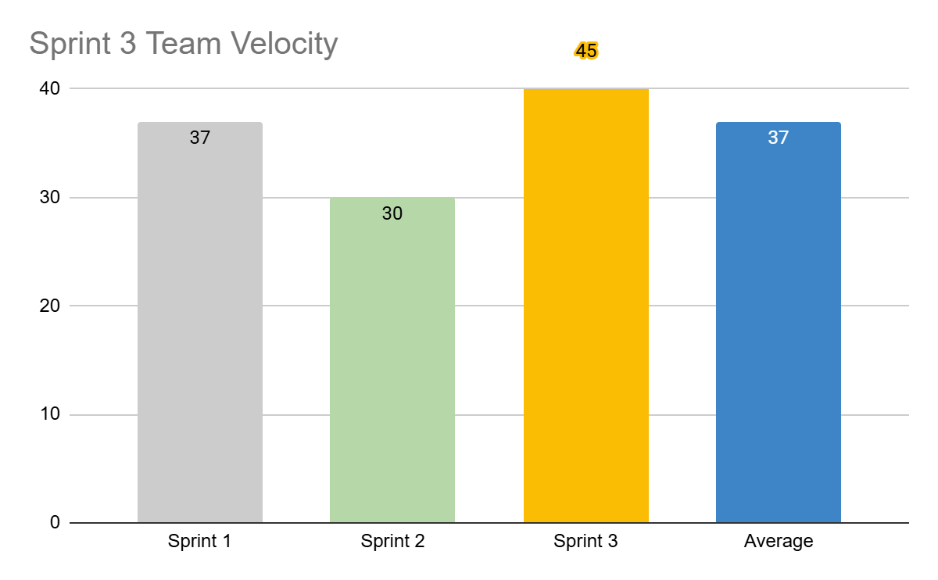
Metrics Sprint 3: Team Velocity
Team Velocity for
Sprint 3: 50
Average Team Velocity: 37
Total points carried over: 5
Notes:
This is might be more accurate: Total Estimated Points : 288
Total Points Delivered: 207
Total Points carried Over: 81
Team Velocity : 207/288 = 0.718* Velocity is the total completed story points per sprint:
Velocity=Total Points Delivered=207
The ratio you calculated (207/288 = 0.718) represents the completion rate (71.8%), which is useful for analyzing sprint efficiency but is not the velocity metric itself.

Slide 60
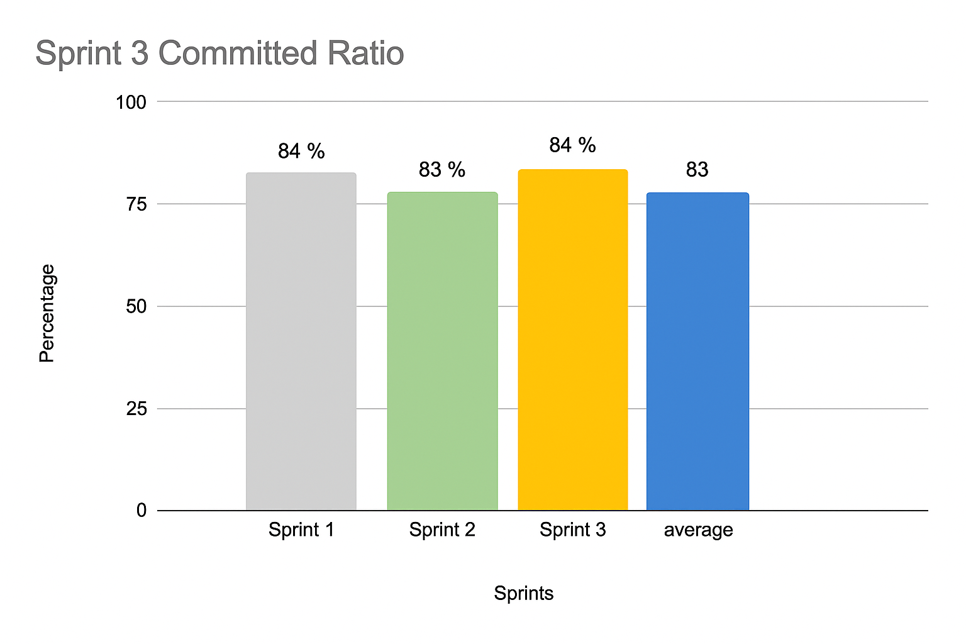
Metrics: Committed/Completed Ratio
Committed Story points for Sprint 3: 50
Completed Story points: 45

Slide 61
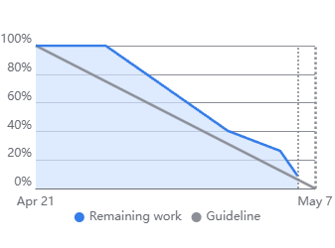
Metrics Sprint 3: Burndown chart
Notes:
CHoose any, one is smoother that why i put here - farham

Slide 62
Sprint 3 Retrospective
What went well?
All members were familiar with the tech stack
Frequent standups helped us stay in sync
Deadlines and code freeze were respected
Peer programming improved collaboration
Documentation workload did not hinder commits
What could be improved?
Be more mindful of committing messages
Code standards need to be clearly followed
Avoid duplicating packages and dependencies
Old features should not be removed without discussion
Our commitments
Use more GitFlow branches for cleaner collaboration
Discuss component structure before development begins
Establish and follow code standards
Notes:
Today, we’re going to look at what went well, what went terribly wrong, and what we’re committing to for the next sprint what actually went well? Surprisingly, alot breaking them into task-focused discussions: 30% less time talking about our lives XP: programming, continuous integration,
we actually met our deadlines and even padded in some extra time
We also broke down communication barriers
On the tech side, feature branches made merging code easier, and Figma streamlined our design work Overall, we had a solid sprint
What went wrong is next and we need to atone for our sins
First, some of us need to be more confident in our opinions. If you get it wrong, its fine we wont all burst out in laughter (I promise) because most of the time we go through long discussions when you had the answer all along
Next, response times were painfully slow at times: scheduling a meeting where everyone is available
We also need to track dependencies better, or we’re going to keep running into blockers
technical analysis and risk assessment because pretending problems don’t exist doesn’t actually make them go away (example student loans)
Let’s work on identifying risks and breaking tasks into smaller subtasks here’s what we’re committing to Everyone should feel comfortable speaking up and contributing ideas We’ll refine our Jira board to make it more structured Better communication and participation about availability will help us stay aligned

Slide 63
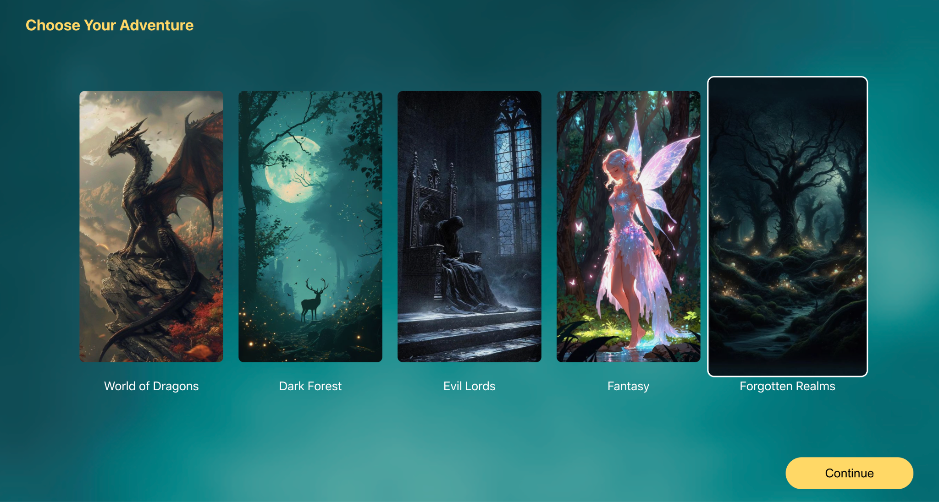
Project Demo

Slide 64
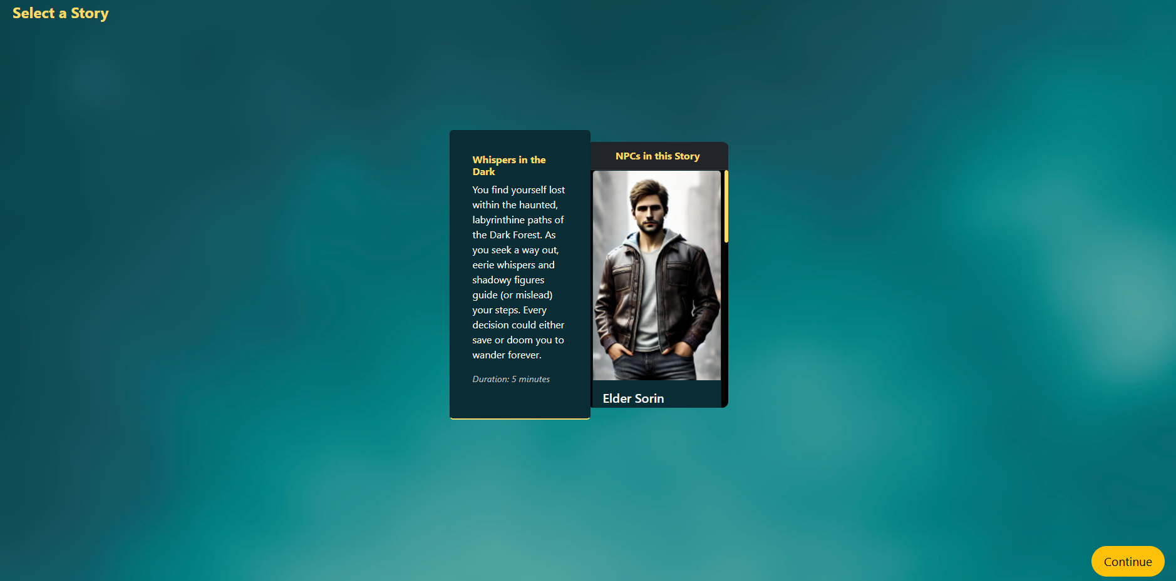
Project Demo

Slide 65
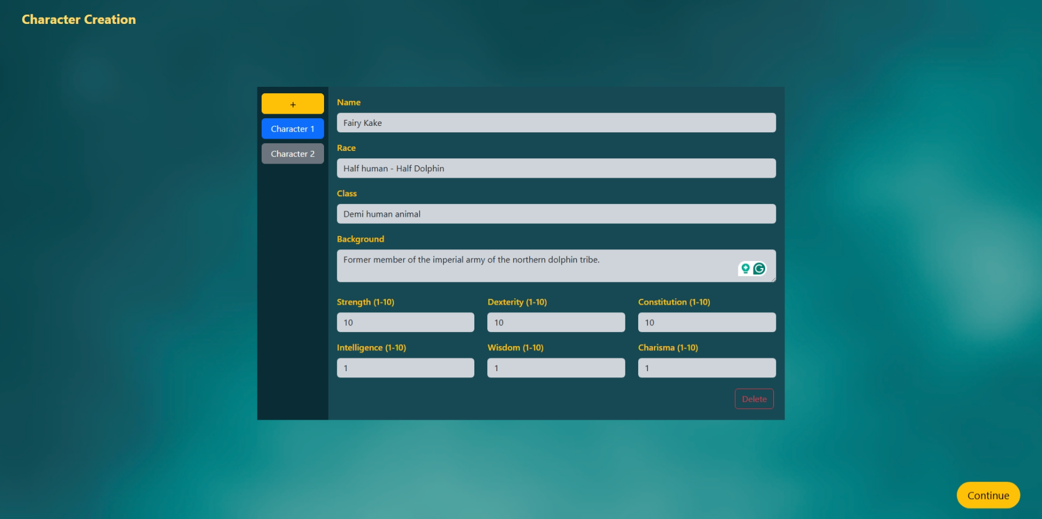
Project Demo

Slide 66
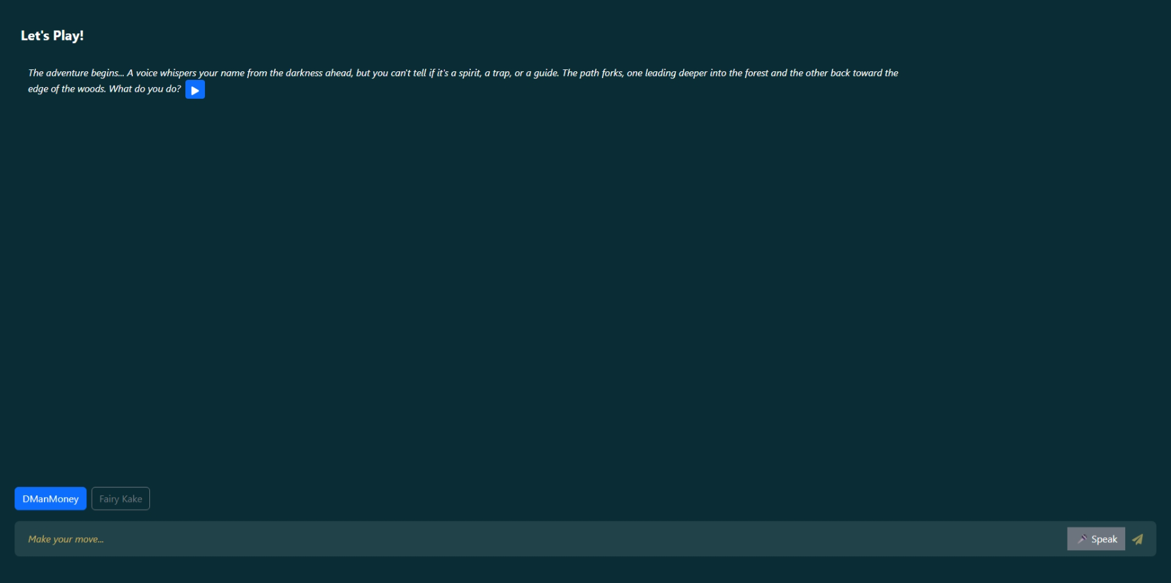
Project Demo

Slide 67
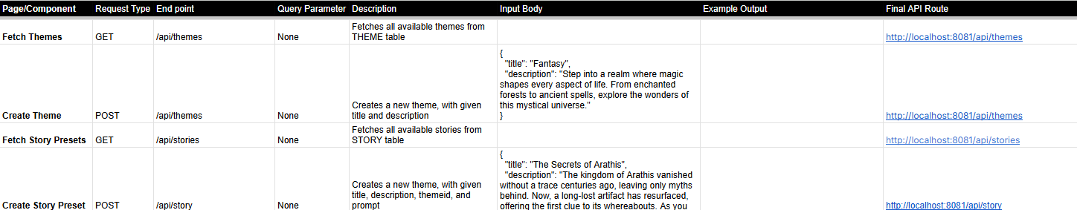
Project API Documentation - Theme & Story Preset APIs

Slide 68
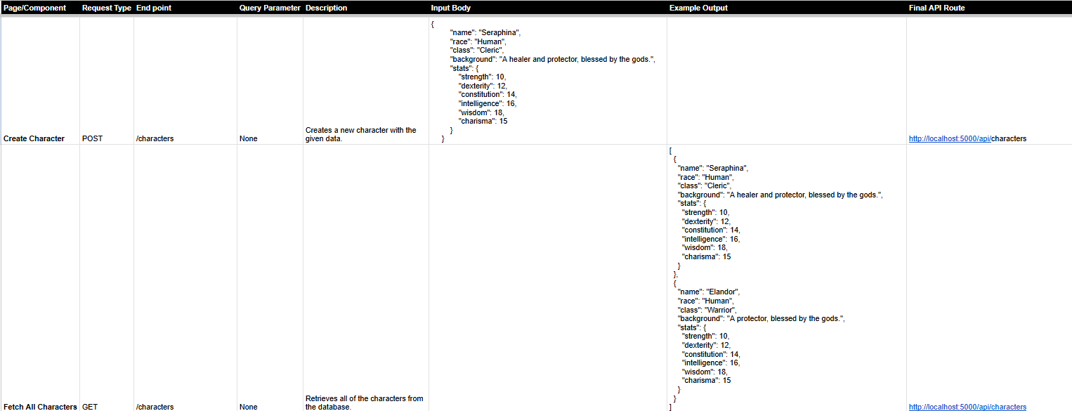
Project API Documentation - Character APIs

Slide 69
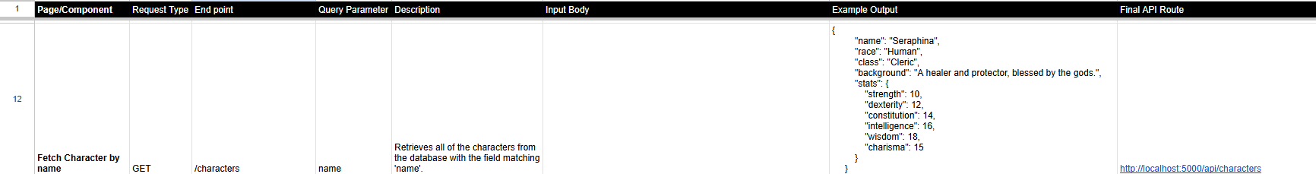
Project API Documentation - Character APIs

Slide 70
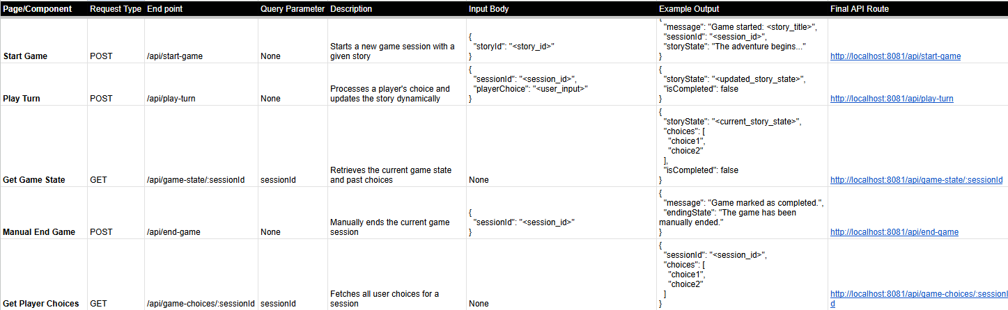
Project API Documentation - Game Session APIs

Slide 71
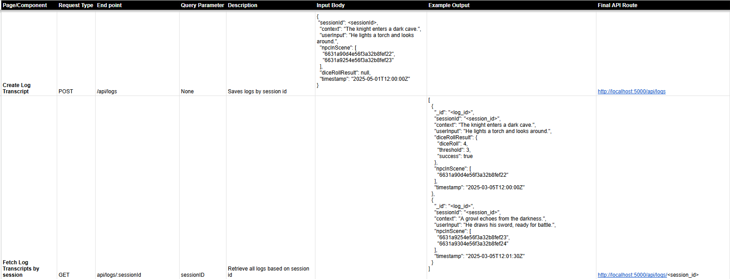
Project API Documentation - Log APIs

Slide 72
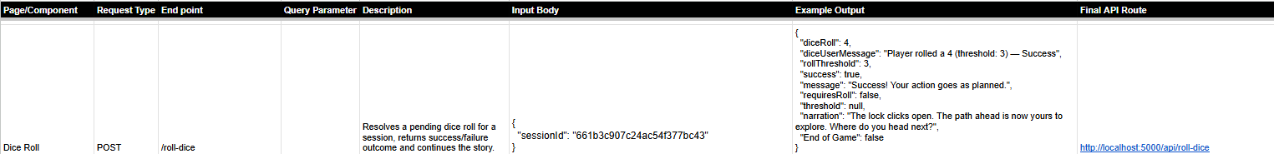
Project API Documentation - Dice Roll API

Slide 73
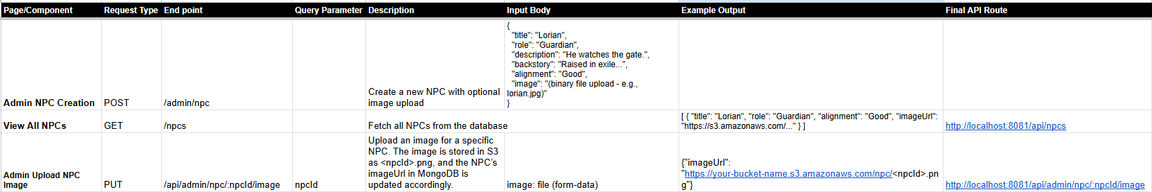
Project API Documentation - NPC APIs

Slide 74
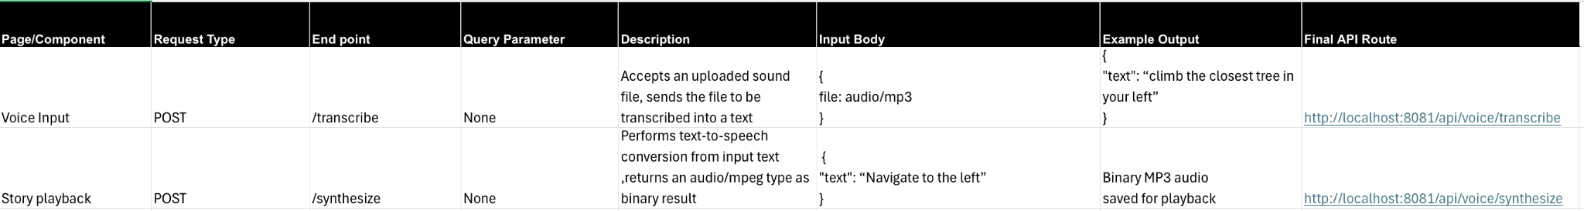
Project API Documentation - Voice APIs

Slide 75
Wiki page link
https://github.com/htmw/2025S-Codesaurus/wiki

Slide 76
APPLICATION DEMO

Slide 77

Thank you

